Slide 1




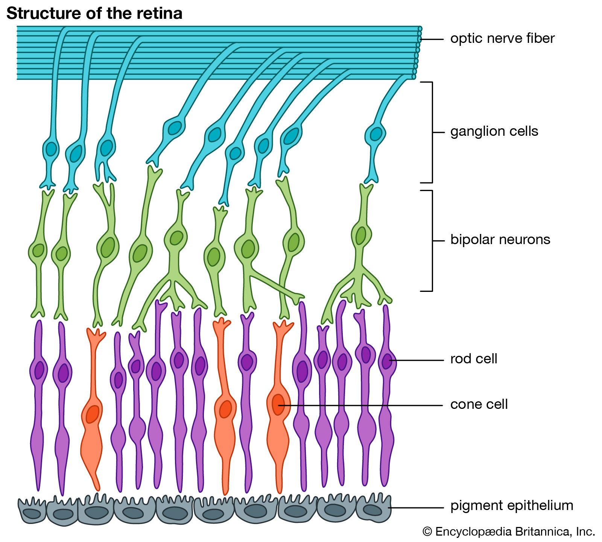
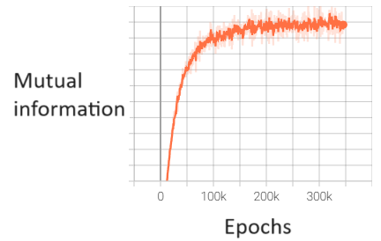
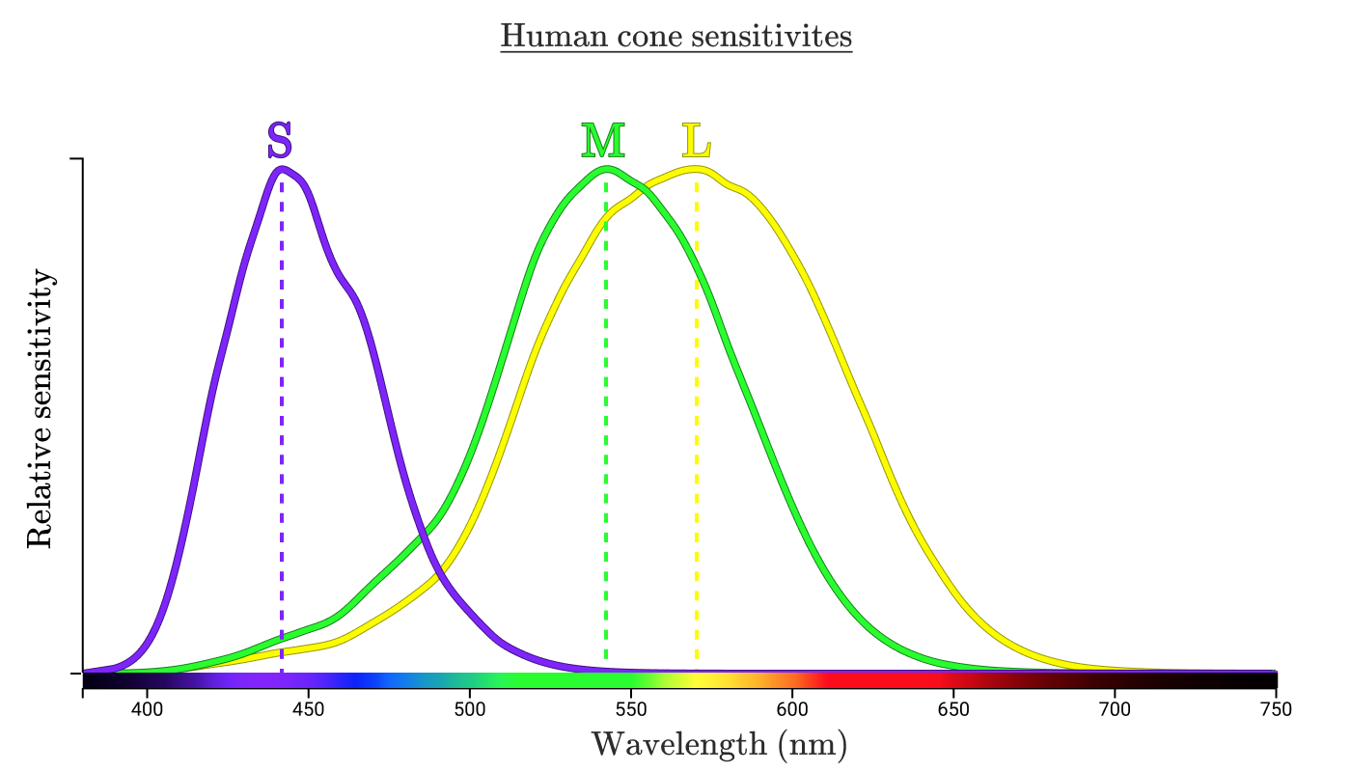
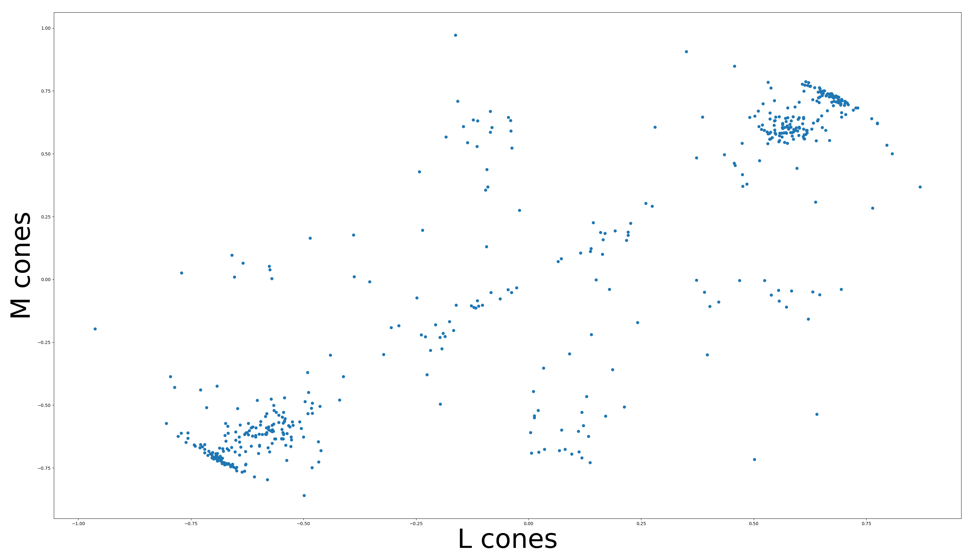
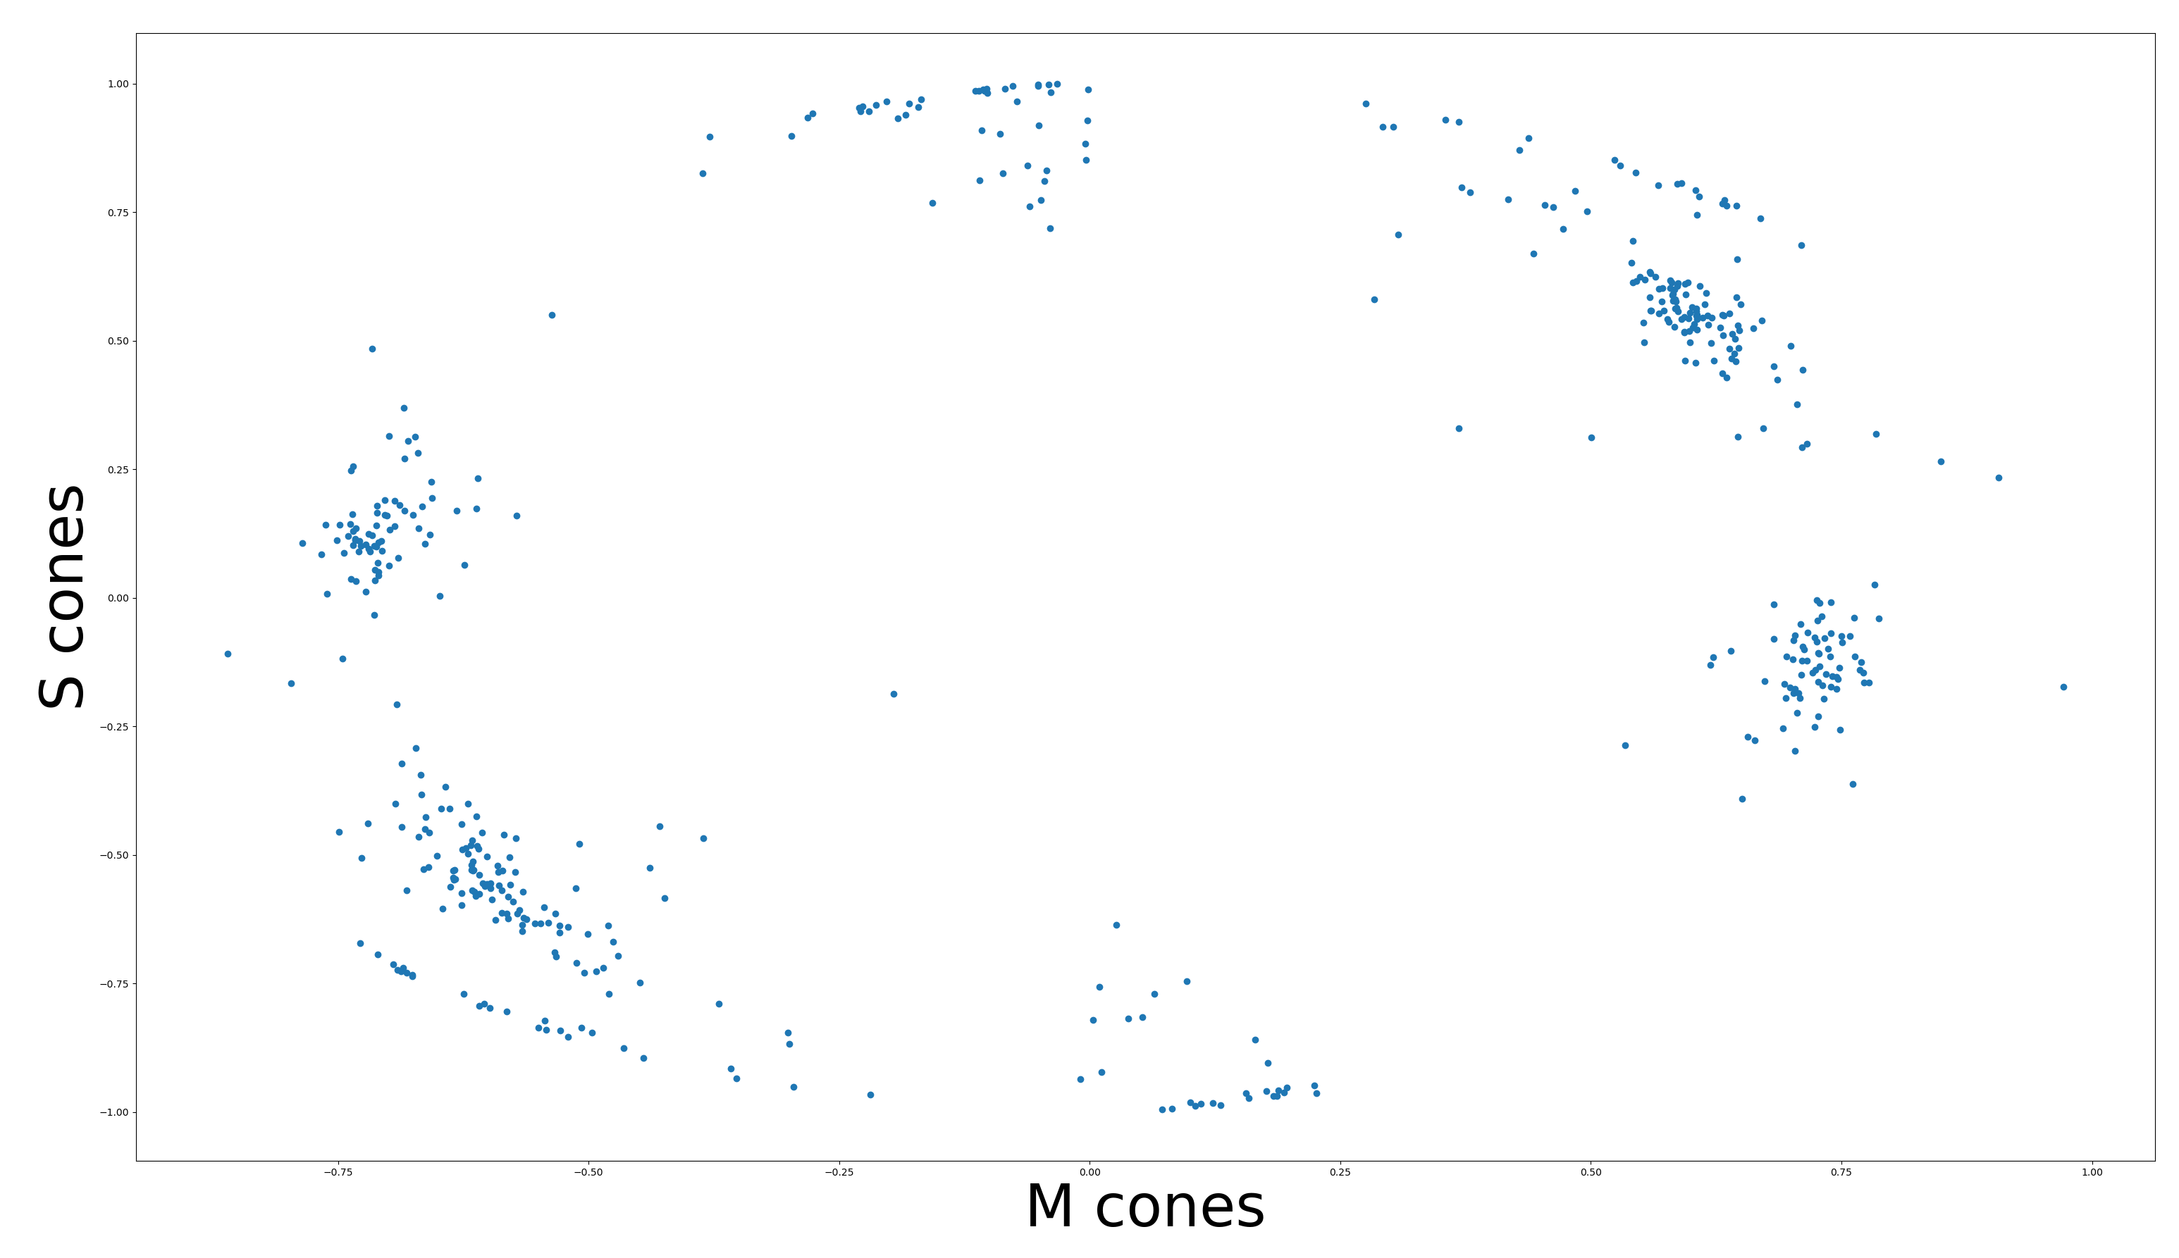
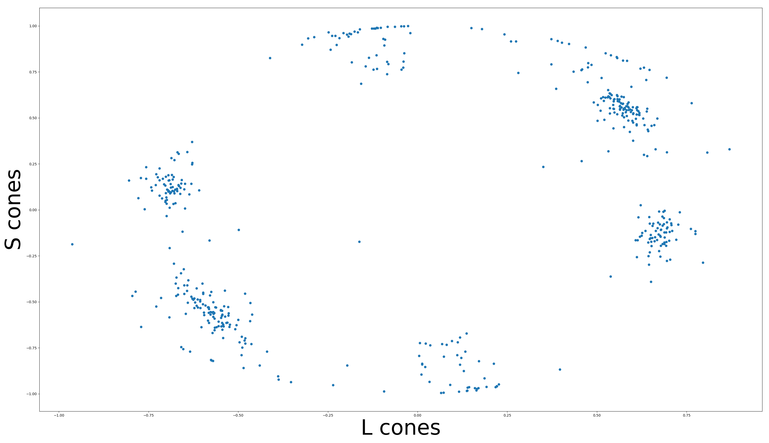
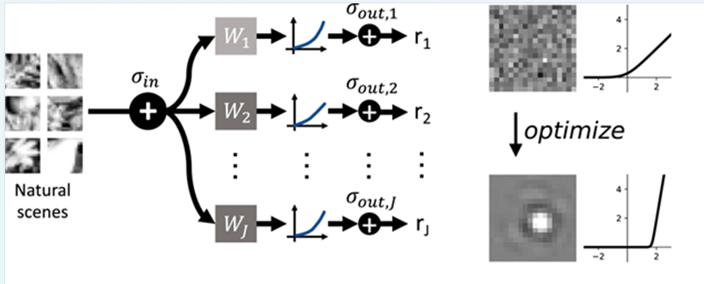
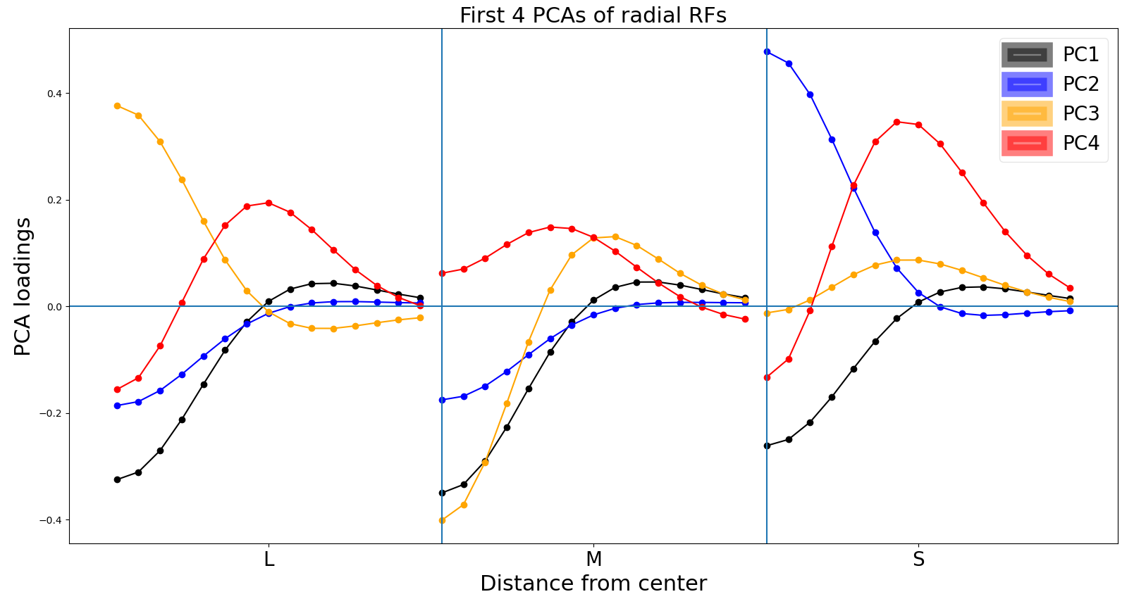
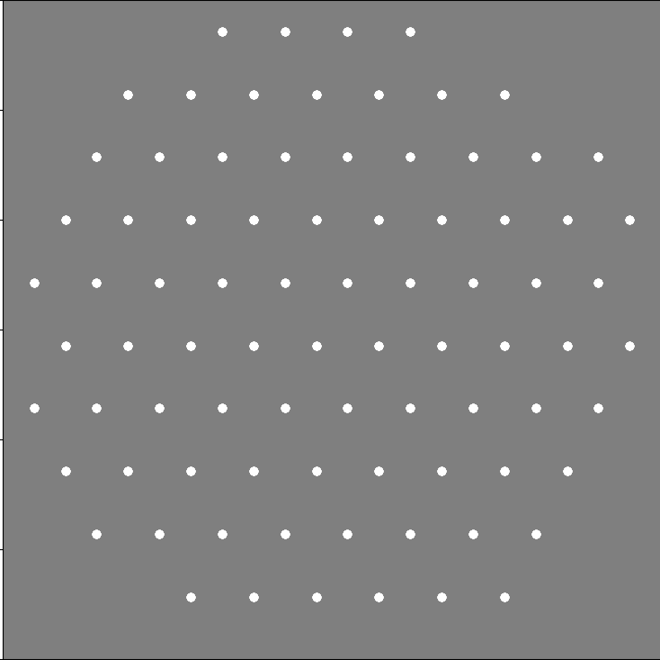
How to efficiently encode chromatic natural images in the retina
David St-Amand, Greg Field and John Pearson
Pearson Lab, Neurobiology Department, Duke University, Durham, NC, USA
Introduction
Results
Efficient coding: Sensory systems should efficiently encode their inputs (Barlow, 1961)
Efficient coding models have been especially successful at explaining how populations of neurons should encode achromatic natural images (Karklin & Simoncelli, 2011; Jun et al., 2021)
The retina encodes the difference between Long, Medium and Short cones. This color-opponency strategy has previously been shown to be efficient (Buchsbaum & Gottschalk, 1983; Atick & Redlich, 1992). However, how a population of retinal ganglion cells should encode different color-opponent signals is less well understood.
Discussion
Model neurons have both chromatic and achromatic center-surround receptive fields
Fovea vs Periphery: Midget cells encode L vs M opponency in the fovea, but not in the periphery. Periphery has L + M center and – L – M surround, similar to findings here.
We also get blue/yellow opponency
Mutual information converges after about 200k epochs
Very strong correlation between L and M cone inputs (r = 0.88)
S inputs are less correlated with L and M inputs (r = 0.36 and 0.4)
Efficient coding model:
PCA shows that most of the variance in receptive fields is achromatic
Training objective:
The weights are drawn from parametrized Difference of Gaussian:
Receptive field centers were fixed to form six different mosaics with same centers:
We trained the model to efficiently encode natural images (12x12x3) from the Kyoto Natural Images Dataset in 498 different neurons

